Slide 1
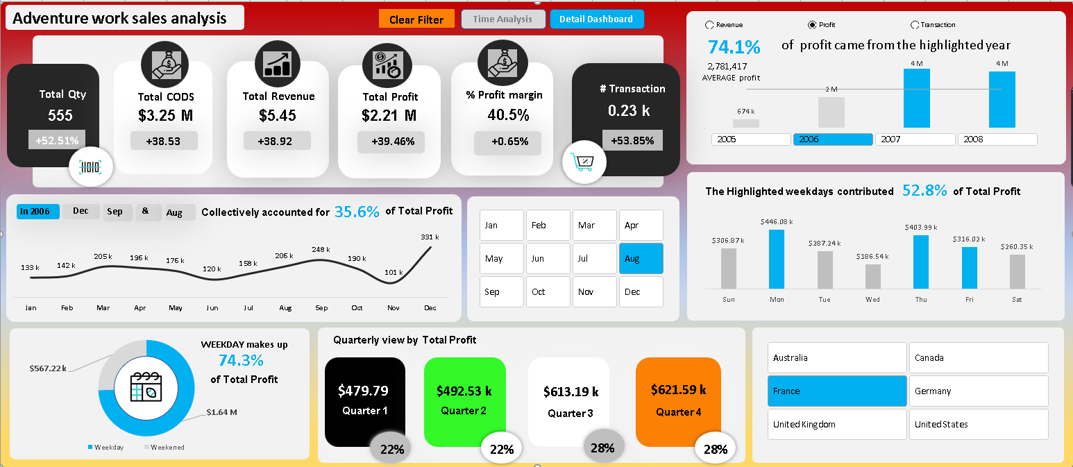
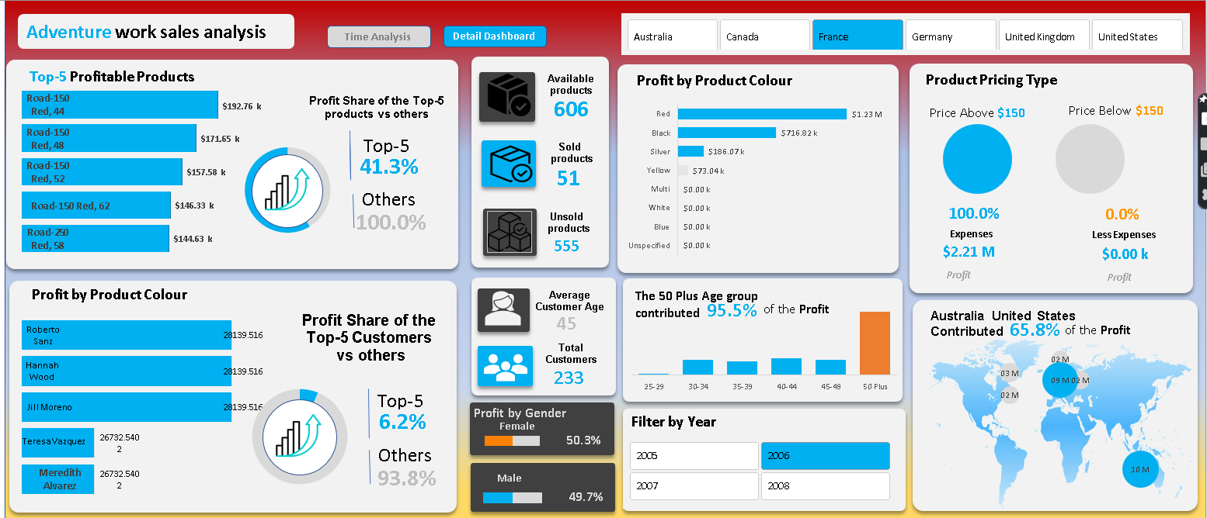
Backend analysis of Adventure work Sales Dashboard (Part 2)
Tool: Microsoft Excel

Slide 2
Remaining KPIs Preparation
Method
Go in to power Pivot
Select fx Measure Option
After selecting fx two options will appeared
New Measure
Manage Measure
Select new measure option

Slide 3
Concept
What is the difference between measure and new measure?
 | New Measure | Manage Measure
Purpose | To create a new calculation or metric that does not currently exist in your data model. | To view, edit, and manage existing measures within your data model.
Usage | You use this option when you need to define a new DAX formula to generate a specific value or metric. | You use this option to maintain, modify, or delete measures that have already been created.
Interface | Opens a dialog where you can specify the name, formula, and other properties of the new measure | Opens a management window listing all existing measures, allowing you to edit their formulas and properties.

Slide 4
KPIs Preparation
Mew Measure of Transaction
Formula: CountRows(Factinternet Sales)
New Measure of All Product
Formula: CountRows(Dim Product)
New Measure of Sold Product
Formula: DistinctCount(Factinternet Sales[Product key])
New Measure of UnSold Product
Formula:[All Product]- [Sold Product]
New Measure of % Profit Margin
Formula: ([Sum of total profit),(Sum of total Revenue],0)

Slide 5
Concept
How to formatting of number in K,M,B?
Go to home option
Select number group
Click on below right small arrow
Number formatting option will be appear
Go to custom option
And write the formula
[<999999]0.00," k";[<999999999]0.00 " M";0.00 " B"

Slide 6
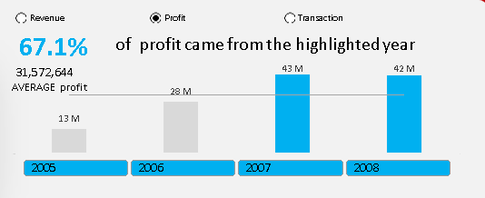
Advanced tool of excel By Using of Developer option
Go in to Developer option
Select Insert
And than select Option button

Slide 7
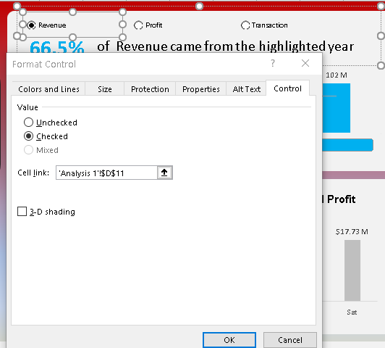
Link option button with other sheet
Right click on Revenue option
Dialog box will appear
Select format control option
IN Cell link option
Reference the sheet which we want to link

Slide 8
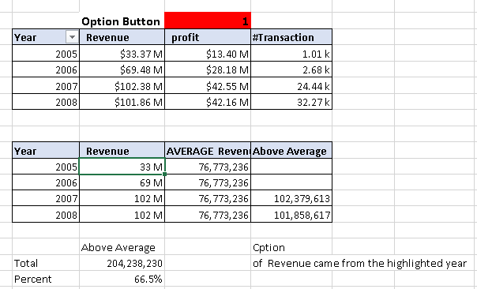
Actual sheet formula vs graphs(1)
Logical test
Chart formatting
Numbering formatting
Sheet reference link
Adobe color.com
Flaticon.com
Slicer icon
Caption linkage

Slide 9
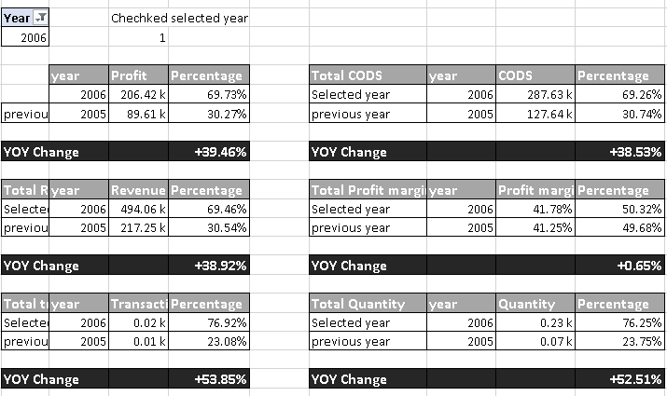
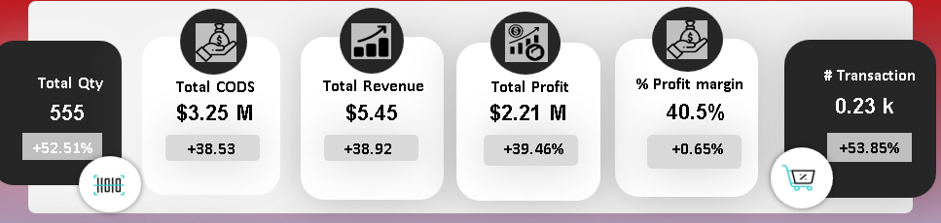
Actual sheet formula vs graphs (2)

Slide 10
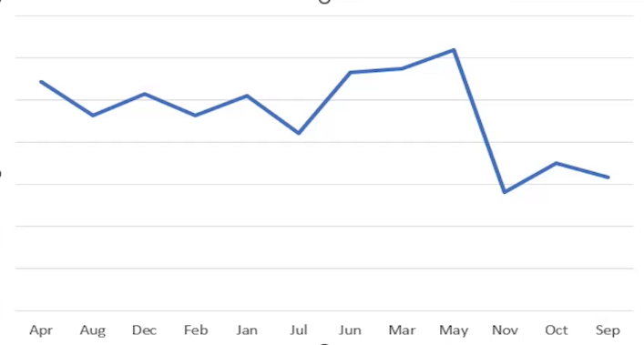
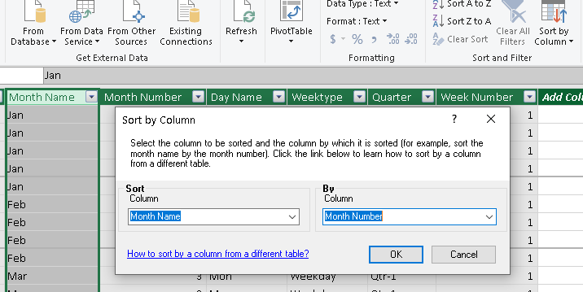
Axis formatting in graph
Month name arrange problem
Go in to power pivot option
Select manage
Manage data will appeared
Select sort by filter column
Dialog box will appear
Now sort column Month Name By Column Month Number

Slide 11
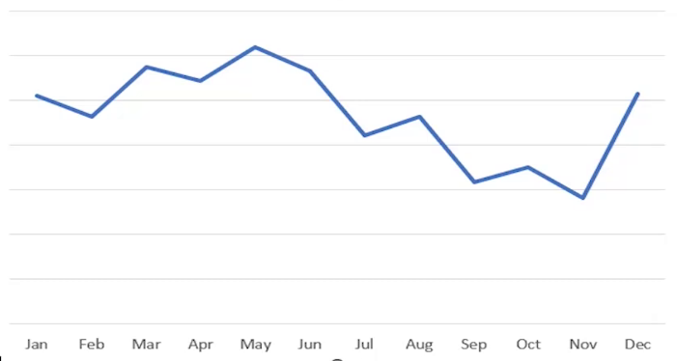
Axis formatting in graph
Month name arrange problem
Before
After Result

Slide 12
Axis formatting in graph
Month name arrange problem
Before
After Result

Slide 13
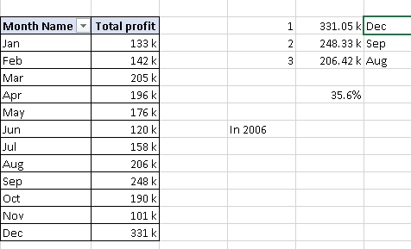
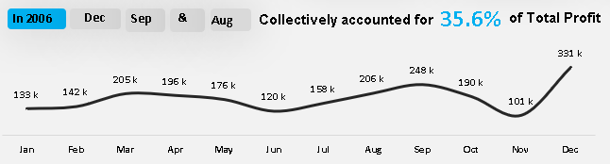
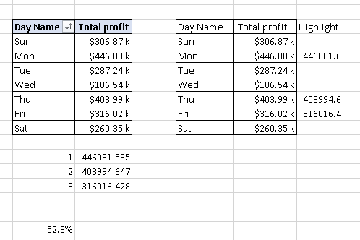
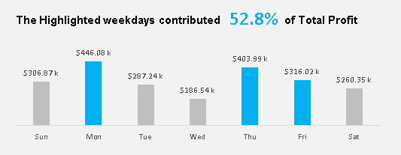
Actual Sheet
Graphs

Slide 14
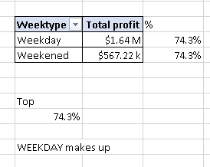
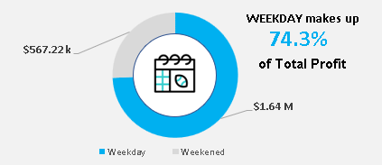
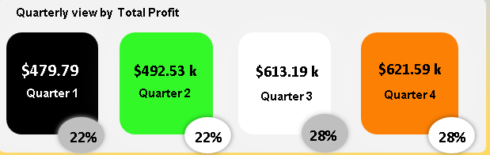
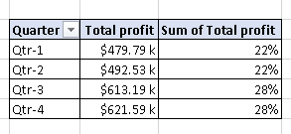
Actual Sheet
Graphs

Slide 15
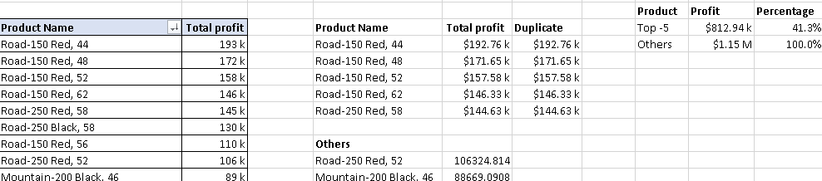
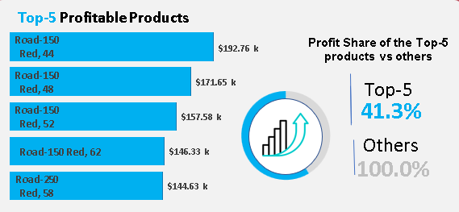
Actual Sheet
Graph

Slide 16
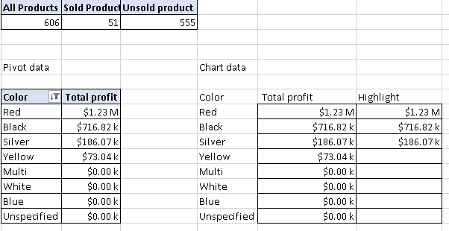
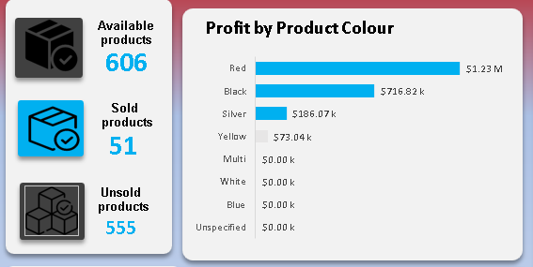
Actual Sheet
Graph

Slide 17
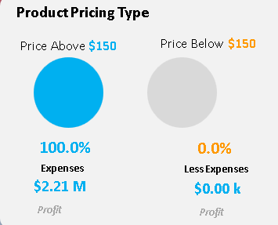
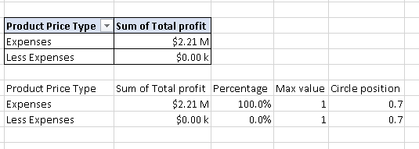
Actual Sheet
Graph

Slide 18
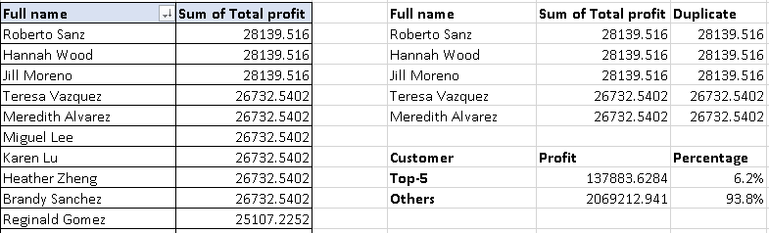
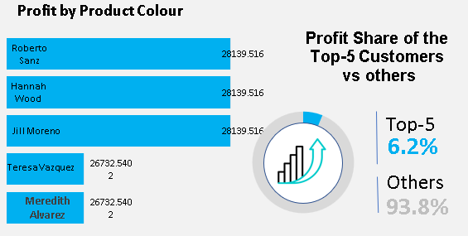
Actual Sheet
Graph

Slide 19
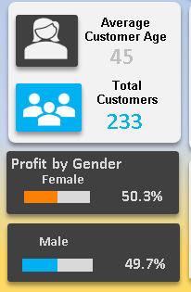
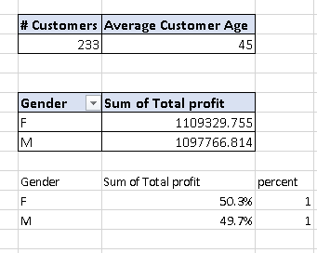
Graph
Actual Sheet

Slide 20
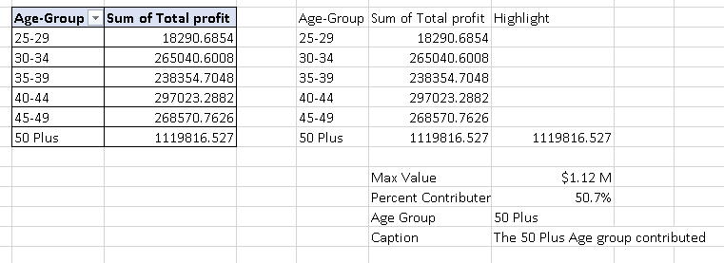
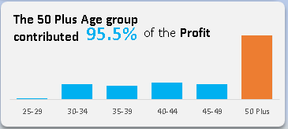
Actual Sheet
Graph

Slide 21
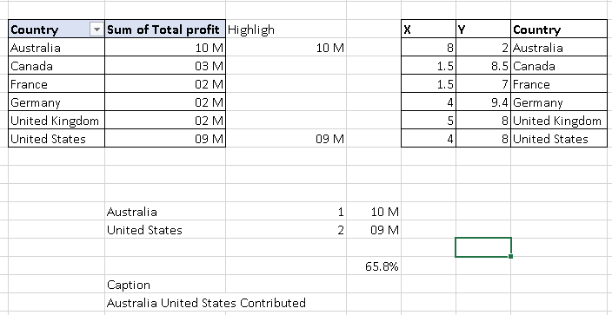
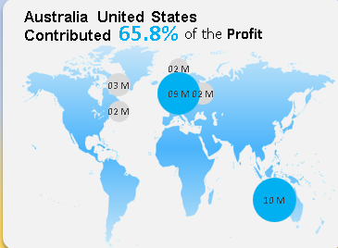
Actual Sheet
Graph

Slide 22
My Learning
How to create new measure?
What is the difference among new measure and manage measure?
How to create KPIs using power pivot?
How to convert numbers in to thousand, millions, and billions?
How to format numbering?
In developer option how option button will use?
Knowledge about logical test
How if ,index, match, large, sum, percentage, maximum, minimum, VLOOKUP and if error function will used?
Chart formatting sense?
Knowledge about dashboard coloring scheme.
How slicer will connected and used in dashboard?
Role of slicer in dashboard creating.
How sheet will link with dashboard?
How macro option will properly used?
What is caption linkage?
How to arrange month and week name axis in chart

Slide 23
Thanks
Stay Tuned for next update
Mahnoor Naseer
mahnoornoorg57@gmail.com

